Slide 1
Week 1 Presentation
11107014
林冠良

Slide 2
GPIO
A signal pin on an integrated circuit or board that can be used to perform digital input or output functions.

Slide 3
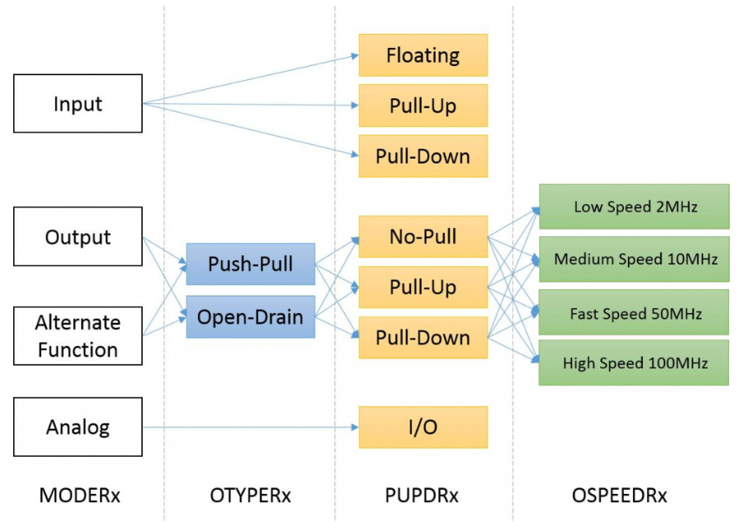
GPIO Functions
Input
Floating
Pull-up/down
Output
Push-pull
Open drain
Alternative functions(PWM, Timer, UART…etc)
Analog

Slide 4
Input
We use GPIO’s input data register(GPIOx_IDR) or data registers(when set to alternate functions) provided by memory to receive data.
Floating
Pin status depending on external signals.
Pull-up/Pull-down
Set default state when signal is floating.

Slide 5
Output
We use GPIO’s output data register(GPIOx_ODR) and Bit set/reset register(GPIOx_BSRR) to control target devices.
Push-Pull
If value store in output register == 0, output low
If value store in output register == 1, output high.
Open-Drain
If value store in output register == 0, output low.
If value store in output register == 1, set High Impedance(Z) to avoid inference.

Slide 6
Analog
Input
When original signals haven’t go through Schmitt trigger, there will be another circuit that (usually) directs the signals to ADC.
Output
There will be an internal circuit that takes the analog signals processed by DAC and output to the external through this pin.

Slide 7
Alternative functions
Determined by two registers
GPIOx_AFRH[31:0]
GPIOx_AFRL[31:0]
These two registers provide ways to select alternation functions.
Different functions maps to different bits of ports.

Slide 8
GPIO Registers
A list of registers to config GPIO pins.

Slide 9
Alternative functions
Every GPIO Port has 10 32-bit registers:
GPIOx_MODER, GPIOx_OTYPER, GPIOx_OSPEEDR and GPIOx_PUPDR
GPIOx_IDR and GPIOx_ODR
GPIOx_BSRR
GPIOx_LCKR
GPIOx_AFRH and GPIOx_AFRL

Slide 10
GPIOx_MODER
GPIOx_OTYPER
GPIOx_OSPEEDR
GPIO port mode register
MODE[15:0][1:0]
00: Input mode
01: General purpose output mode
10: Alternate function mode
11: Analog mode (reset state)
GPIO port output type register
OT[15:0]
0: Output push-pull (reset state)
1: Output open-drain
GPIO port output speed register
OSPEED[15:0][1:0]
00: Very low speed
01: Low speed
10: High speed
11: Very high speed

Slide 11
GPIOx_PUPDR
GPIOx_IDR
GPIOx_ODR
GPIO port pull-up/pull-down register
PUPD[15:0][1:0]
00: No pull-up, pull-down
01: Pull-up
10: Pull-down
11: Reserved
GPIO port input data register
ID[15:0]
These bits are read-only. They contain the input value of the corresponding I/O port.
GPIO port output data register
OD[15:0]
These bits can be read and written by software.

Slide 12
GPIOx_BSRR
GPIOx_LCKR
GPIO port bit set/reset register (ODRx)
Bits 31:16
0: No action
1: Resets the bit
Bits 15:0
0: No action
1: Sets the bit
GPIO port configuration lock register
Bit 16 LCKK: Lock key
0: Lock key not active
1: Lock key active.
Bits 15:0 LCK[15:0]: Port x lock I/O pin y

Slide 13
GPIOx_AFRL
GPIOx_AFRH
GPIO alternte function low register
AFSELy[3:0]: Alternate function selection for port x pin y (y = 0..7)
GPIO alternate function high register
AFSELy[3:0]: Alternate function selection for port x pin y (y = 8..15)

Slide 14
Timer
As the name says, it counts evenly according to the user configuration.

Slide 15
Timer
Counter max values depends on the bit amount of a timer, if a timer is 8-bit, then it counts from 0-255, then creates an interrupt and resets to 0, over and over.
Prescaler
How fast a timer counts
Counter Period
When does a timer reset
Common hardware functions
Output compare (OC): toggle a pin when a timer reaches a certain value
Input capture (IC): measure the number of counts of a timer between events on a pin
Pulse width modulation (PWM): toggle a pin when a timer reaches a certain value and on rollover. By adjusting the on versus off time (duty cycle), can effectively control the amount of electrical power going to another device.

Slide 16
Functional Modes
Input capture mode
When an input capture event happened, TIMx_CCR will store the counter value of the moment of trigger signal, and CCxIF (interrupt flag) will be set to 1 automatically be hardware, refers to an input capture event happened. And we can setup interrupt handling or DMA request.
PWM input mode
Capture PWM signal cycle in TI1(TIMx_CCR1) and duty cycle(TIMx_CCR2).
Force output mode
Can force set outputting compare signals to active or inactive status under output mode, ignoring the compare values between output compare registers and counters.
Output compare mode
Control the signals you want to output or to notify a specific time period has pass.

Slide 17
Coding
LED Controlling

Slide 18
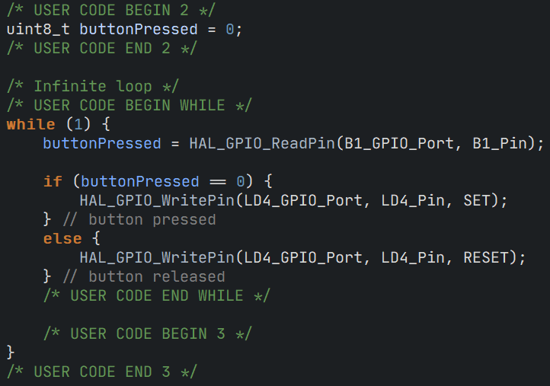
LED Controlling
Set PA5(LD4) to GPIO_Output
Set PC13(B1) to GPIO_Input
Initialize a uint8_t variable “buttonPressed”
In while loop, get pin value using HAL_GPIO_ReadPin()
Set pin value in if condition using HAL_GPIO_WritePin()

Slide 19
Coding
LED Timer

Slide 20
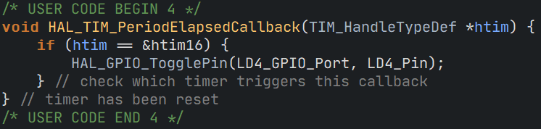
LED Timer
Activate TIM16
Prescaler: 1600-1
Counter Period: 5000-1
16MHz / 1600 / 5000 = 2Hz (0.5s/tick)
Overload HAL_TIM_PeriodElapsedCallBack() in main.c to check whenever an interrupt happedend , if it is caused by TIM16, toggle LD4 pin.

Slide 21
Coding
LED Breathing

Slide 22
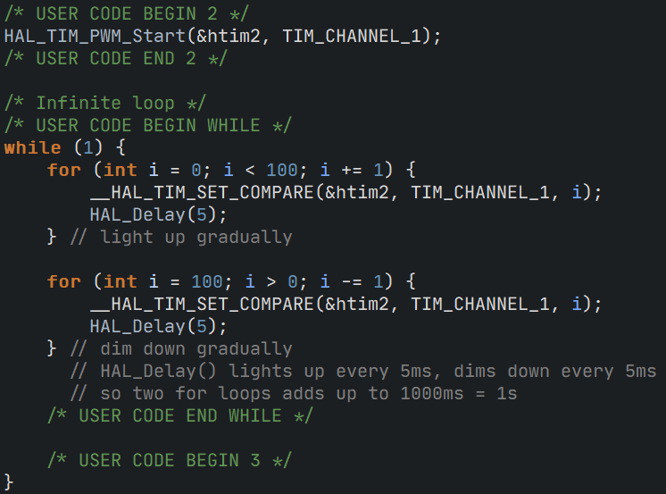
LED Breathing
Activate TIM2
Prescaler: 1600-1
Counter Period: 100-1
16MHz / 1600 / 100 = 100Hz (10ms/tick)
Set PA5 as TIM2_CH1
Call HAL_TIM_PWM_Start() to start timer with PWM
Create two for loop, each do __HAL_TIM_SET_COMPARE(&htim2, TIM_CHANNEL_1, i), and delay 5ms.
5ms x 100(index limit) x 2(loops) = 1s

Slide 23

Thank you for your listening
林冠良
Noah_Lin@wistron.com
https://github.com/popshia

